Slide 1
Security Project Report
Group 68
Kim Csoka (10722831) Hayden Williams (11132817) Ryan Indrananda (10852565)

Slide 2




Content
TCP Protocol
Identified Anomalies
The attack - SYN flood
Mitigation Strategies (On Premise and Outsourced)

Slide 3
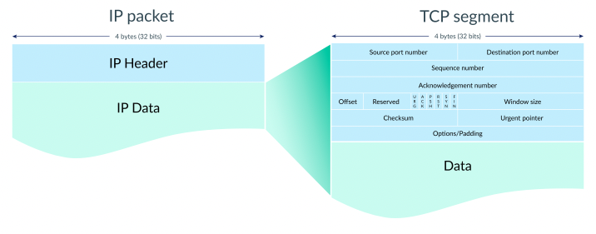
Transmission Control Protocol (TCP)
Operates at Layer 4 (Transport Layer) of the OSI model
Intermediary between two applications used to transfer data
Data arrives in order
Data has minimal errors
Duplicate data gets discarded
Lost or damaged data gets re-sent

Slide 4

Connection Establishment (3-way Handshake)
Seq # 9001 | ACK # 0 | SYN # 1
Seq # 5001 | ACK # 9002 | SYN # 1
Seq # 9002 | ACK # 5002 | SYN # 0

Slide 5

Data Transfer
Computer and server opened connection
Computer sends a packet of data with a sequence number
Server acknowledges the data by setting the ACK bit and increasing the acknowledgment number by the length of received data
Continues until all data is sent

Slide 6

Connection Termination (4-way Handshake)
Client sends segment with FIN bit 1 and enters FIN_WAIT_1 state
Server receives segment, frees up buffers, enters CLOSE_WAIT state and sends ACK back
Client enters FIN_WAIT_2 state and terminates client to server connection
Server sends segment with FIN bit 1 and waits for an ACK
Client acknowledges servers segment and enters TIME_WAIT state
Waits a period of time and closes connection and releases all resources

Slide 7
Capture File - Identified Anomalies
High volume of incomplete SYN segments -> Incomplete three-way handshake
Source only requests SYN
No server acknowledgements (SYN-ACK_
No client response (ACK) for connection
All ports of destination 200.200.1.77 being targeted within short-time frame
Spoofed addresses
Same TTL values of 64 for each packet indicating coming from same router

Slide 8



DOS SYN Flood attack
Attacker with Spoofed IPs
200.200.1.77
SYN
SYN-ACK
????????
User
200.200.1.77
Connection unavailable - all ports exhausted

Slide 9

Mitigation Strategies (On-Premise)
Micro Blocks
Admins allocate a micro-record in server memory handling incoming SYN requests
TCP Stacks
Reducing timeout until stack frees allocated memory to a connection.
RST cookies
File server intentionally sends false SYN-ACK for client’s first request, creating an RST packet, informs server of a failure. If received, server recognises the request, therefore client is legitimate.
SYN cookies

Slide 10

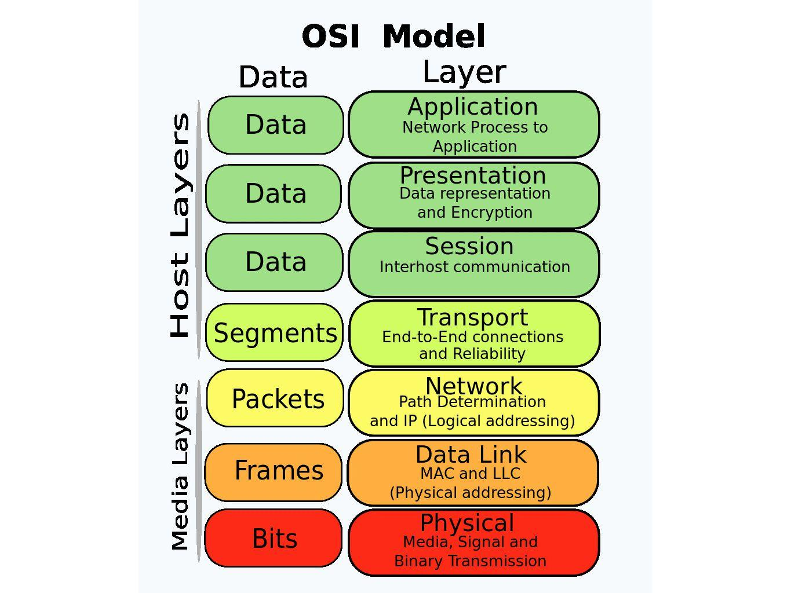

SYN Cookies Strategy
Cryptographic hashing
File server replies to SYN request with crafted SYN-ACK responses without adding to the SYN queue
Protects SYN queue from overloading under SYN flood attacks
Layer 4 (Transport layer) of the OSI model

Slide 11
Benefits and Limitations of SYN Cookies
Benefits | Limitations
Cryptographic initial sequence numbers = difficult for potential attackers to predict Not necessary for clients to be aware of use of SYN cookies No allocation of resources following first SYN packet by file server No further alterations to specifications of TCP protocol required | Not all TCP data fits into 32-bit long ACK/SEQ number field, some TCP options will be unavailable Computationally expensive and increase load on file server’s resources Does not reduce traffic to file server, potentially renders it futile against future flooding attacks targeting bandwidth

Slide 12

Mitigation Strategies (Outsourced)
Cloudflare - global vendor - “secure, reliable, private, fast internet”
Increasing backlog queue (number of half-open connections that devices allow to cater for higher number of SYN packets)
Oldest half-open connection is recycled
Cloudflare mitigates by standing between targeted server and SYN flood

Slide 13
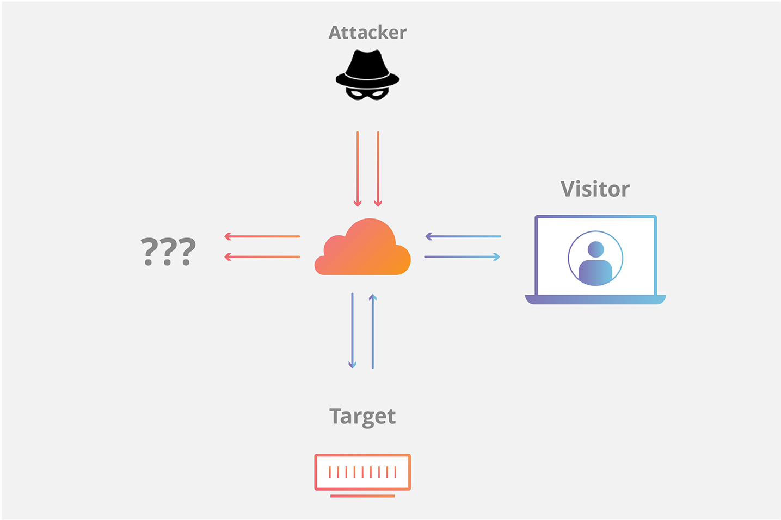

Slide 14

Service Level Agreement (SLA)
Agreement between customer and vendor - offered provisions
Formalises communication pipeline between vendor and client
Strengthens trust between parties
Expectations between parties are clearly defined
Legally enforceable
Why?

Slide 15

Key Performance Indicators (KPIs)
Quantifiable metrics of how well vendors fulfill and perform in comparison to agreement
E.g. 99.9% service uptime, 24/7 support
Set important benchmark in vendor’s capability in managing client’s network and its vulnerabilities

